Slide 1


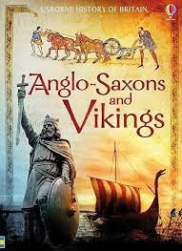

During this term we will be learning…
English | We will be basing our Narrative unit on The Lion, The Witch and The Wardrobe by CS Lewis. We will be writing dialogue, setting and character descriptions, diary entries and letters. We will also be using non-fiction texts to research our History topic and will use the exciting story of the Sutton Hoo discovery for diary writing. We will read the Last Bear by Hannah Gold and write diaries and letters. It also links our English and Geography work on climate change when we will aim to become ‘courageous advocates’.
Maths | Multiplication and Division, Length and Perimeter, Fractions and Decimals, Mass and Capacity.
History | Develop an understanding of why people invaded and settled, learning about Anglo-Saxon beliefs and the spread of Christianity and assessing the contribution of the Anglo-Saxons to modern Britain.
Geography | Locate Antarctica and describe it’s location and physical and human features. We will use 4 figure grid references to plot the expedition of Ernest Shakleton.
RE | Jesus the man who changed lives. The joy and sadness of easter.
Art and Design | Abstract Shape and Space: Exploring how shapes and negative spaces can be represented by three dimensional forms. Manipulating a range of materials, children learn ways to join and create free-standing structures inspired by the work of Anthony Caro.
DT | Textiles: Learn and apply two new sewing techniques – cross-stitch and appliqué. Utilise these new skills to design and make a cushion.
Science | Forces and Magnets: By investigating motion on different surfaces, children learn about friction and compare its uses and disadvantages. They broaden their experience in working scientifically as they investigate forces. Pupils explore the properties of different magnets and apply this to understand their uses. Light :Exploring the link between light and darkness, observing reflections and investigating different factors that affect shadows.
Computing | Data Handling: understand what a database is. Learning the meanings of records, fields and data. Further exploration will lead to the development of the ideas of sorting and filtering
Music | Pentatonic Melodies and Composition on the theme of Chinese New Year.
PE | Dance and Gymnastics Tennis and Outdoor and Adventurous Activities
French | Language and vocabulary of food.
PSHE | Health and well being The Changing body.
How can you help your child at home?
Ensure that your child understands the meaning of the key vocabulary for our topics and help them to research the topics we will be covering this term. Talking to your child is the best way to expand their vocabulary and improve their general knowledge. Read lots of books and look for interesting words and phrases in them. What do these words mean and how could they be used in an alternative context when they are writing? Home reading is a way for children to practise and consolidate the skills they have been taught. We expect children to read at home at least three times a week to support these skills and develop their comprehension skills and vocabulary.
Thank you for all your continued support. If you have any questions or concerns please just ask!
Key Information for this term
PE is on Tuesday and Wednesday.
Maths homework is given on
Thursday to be returned the following Thursday.
Spelling homework is given on Friday to be returned the following Friday.
Spelling Test on Friday.
Year 4 will be taking the Multiplication Tables Check in May. It is essential that they know their tables. Please ensure children go on TT Rockstars at least twice a week.
What are we reading this term?

Slide 2

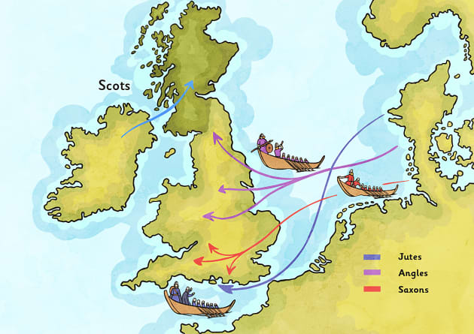
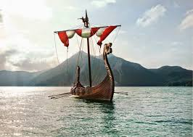

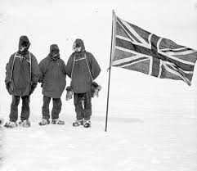
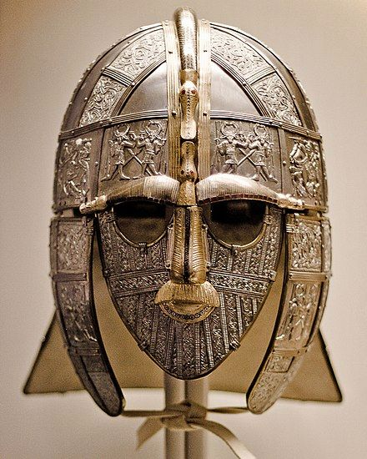
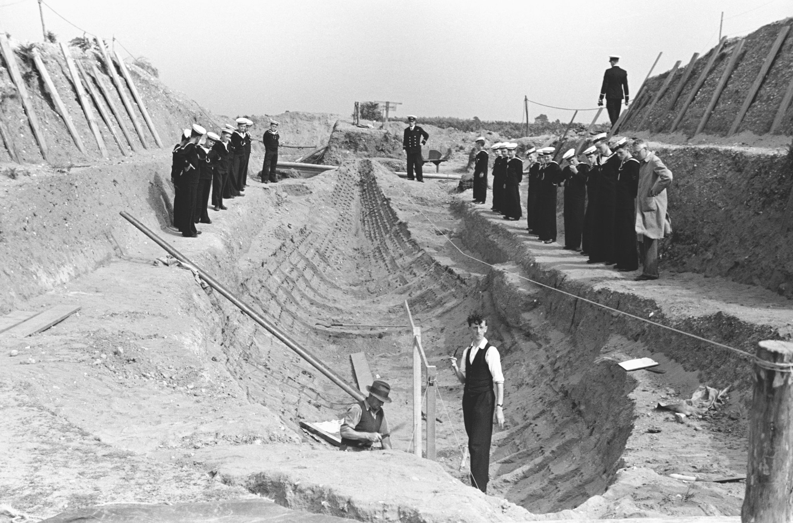

Key vocabulary
Angles, Britons, convert, empire, inference, invasion, Kingdom, missionary, paganism, Pope, Romans, Saxons, Jutes, settlement, settlers, Vikings.
Climate, climate zone, compass points, direction, drifting ice, hemisphere, ice sheet, ice shelf, iceberg, lines of latitude, lines of longitude
Questions to get you thinking...
Who were the Anglo Saxons?
What was Britain like at the time?
Why did they choose to invade Britain?
Where did they settle?
What did they believe in?
Where is Antarctica?
What is the climate like?
Who lives there?
What happened on the Shakleton expedition?
Spring Curriculum Overview
Year 3/4
Who were the Anglo Saxons and why did they invade?
Who lives in Antarctica?
We will try and solve the mystery of Sutton Hoo!
We start the term with learning all about the invasion and settlement of Britain by the Anglo Saxons. We will learn the reasons why the Angles, Saxons and Jutes came to Britain, where they decided to settle, and how they lived. We will also find out about Anglo-Saxon beliefs and the spread of Christianity.
During the second half term we will move on to our Geography topic of Antarctica. We will look at where Antarctica is and describe it’s climate, human and physical features. We will also use grid references and plot coordinates to follow the expedition of Ernest Shackleton.
Useful websites
https://www.natgeokids.com/uk/discover/history/general-history/anglo-saxons/
https://planbee.com/blogs/news/anglo-saxon-ks2-facts
https://school-learningzone.co.uk/key_stage_two/ks2_history/british_history_/the_anglo_saxons/the_anglo_saxons.html
https://www.dkfindout.com/uk/history/anglo-saxons/
http://www.primaryhomeworkhelp.co.uk/saxons.htm
https://www.nationaltrust.org.uk/visit/suffolk/sutton-hoo
https://discoveringantarctica.org.uk/
https://www.bbc.co.uk/bitesize/articles/zjg46v4
Christian Value
Our Christian Value this term is ‘Forgiveness’.
Our vision is ‘Believe and Achieve’.
We will be thinking about these in everything that we do this term.
"Life in all its fullness"
John 10:10
You will find lots more information about the Year3/4 curriculum on our school website.

