Slide 1

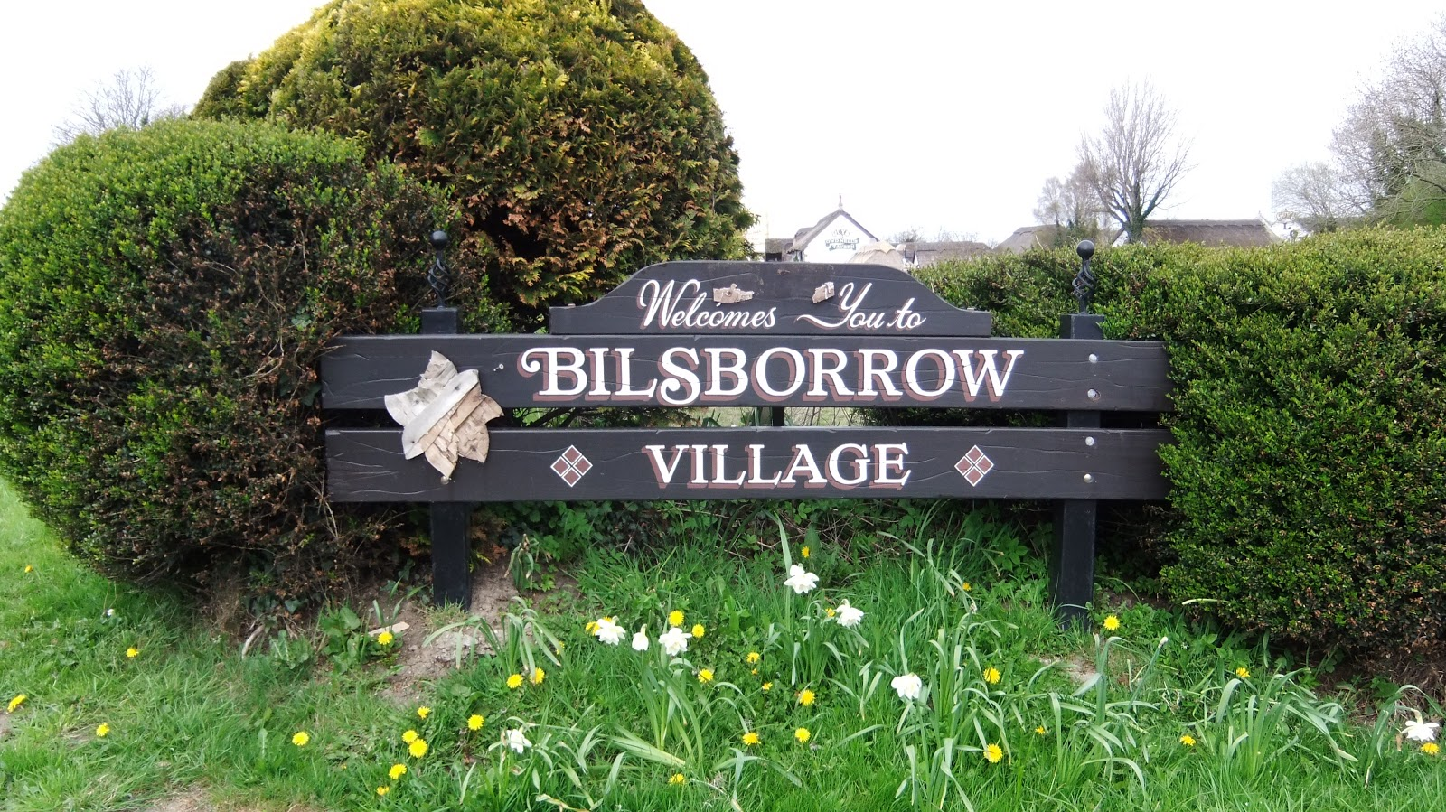
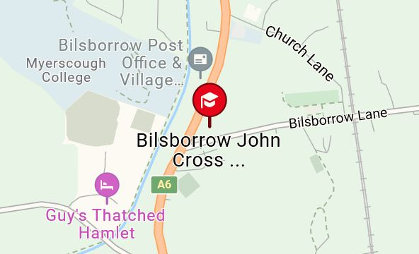

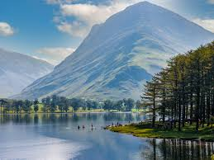
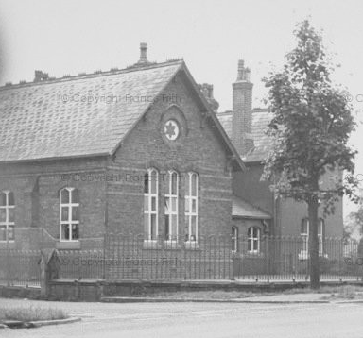
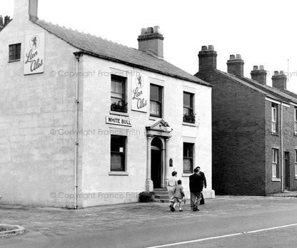

Key vocabulary
Mountain, lake, tourist, river, canal, commute, compare, county, facilities, land use, local.
Artefact, primary/secondary source, primary/secondary, evidence, analyse, oral history, narrative, investigate, infer, change, continuity, events.
Questions to get you thinking...
Where is Bilsborrow?
What is it like?
What is the Lake district?
Where is it?
What geographical features can I find?
Why do people visit the Lake District?
How long has Bilsborrow been a village?
What was it like in the past?
How has it changed?
What happened here?
Summer Curriculum Overview
Year 3/4
Where in the world is Bilsborrow?
What was Bilsborrow like in the past?
We start the term with finding Bilsborrow on a map and considering it’s place within the northwest of England. We will explore the Lake District environment and investigate why so many people visit.
During the second half term we will learn about the history of Bilsborrow and what it would have been like to live here in the past. We will also consider how Bilsborrow has changed.
Please see the individual subject areas in the booklet for work covered.
Useful websites
https://www.lakedistrict.gov.uk/
https://www.genuki.org.uk/big/eng/LAN/Bilsborrow
https://www.francisfrith.com/bilsborrow
https://www.garstangheritagesociety.org/home/poppytrail/bilsborrow-myerscough/
https://getoutside.ordnancesurvey.co.uk/guides/map-reading-skills-for-children/
Christian Value
Our Christian Value this term is ‘Hope’.
Our vision is ‘Believe and Achieve’.
We will be thinking about these in everything that we do this term.
"Life in all its fullness"
John 10:10
You will find more information about the Year 3/4 curriculum on our school website.

Slide 2



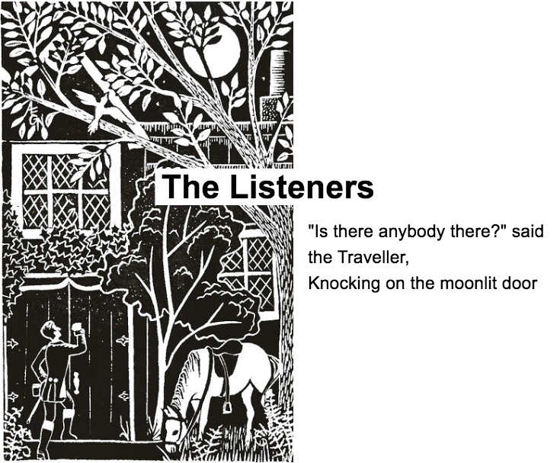
During this term we will be learning…
English | We will be basing our Adventure and Mystery Narrative units on Varjak Paw by SF Said and The Uncorker of Ocean Bottles by Michelle Cuevas. We will be writing dialogue, setting and character descriptions, diary entries and letters. In Non-Fiction will be writing book reviews and Explanations. We will also study the narrative poem The Listeners by Walter De La Mare.
Maths | Decimals, Money, Time, Shape, Statistics, Position and Direction.
History | We will be researching the history of Bilsborrow village and look at how it has changed over the years. We will use maps, artefacts and primary and secondary sources to gather evidence.
Geography | We will study Bilsborow as a location and look at where it sits in the north west of England. We will also study the Lake District as a region and investigate why so many people like to visit it. We will also learn how to use OS maps.
RE | Called by God: Children will have the opportunity to consider what it means to be called by God and the responses people have made in the past and still do today when they hear a call from God. David and the Psalms: We will explore the Story of David and his strengths and qualities. We will also read the Psalms and use them to discover more about the nature of God.
Art and Design | Using the flora and fauna of tropical rainforests as a starting point, children develop drawings through experimentation and textile-based techniques to design a repeating pattern suitable for fabric.
DT | Our cooking and nutrition unit includes opportunities for children to learn about seasonal foods and we will create a seasonal food tart.
Science | Plant Reproduction: We will discover how plants reproduce in the context of the life cycle of a flowering plant, gather data on plant growth and investigate the structure and function of the parts of a flowering plant. We will also be growing our own vegetables, sowing the seeds and taking care of them.
Computing | Emailing: Learn how to send, edit emails, and add attachments. Creating Media: Develop filming and editing video skills through the storyboarding and creation of book trailers.
Music | Traditonal Instruments and improvisation (Theme: India)
PE | Athletics, Striking and Fielding games, Outdoor and Adventurous Activities.
French | Portraits: Learning adjectives for describing people’s physical appearance and their personality. Creating simple sentences ensuring that the adjectives agree with the gender of the noun.
PSHE | Economic Wellbeing: Introduction to budgeting, learning about the different paying methods, the emotional impact of money, the ethics of spending, potential jobs and careers and learning that anyone can aspire to anything. Transition: moving from Year 3 to 4 and Year 4 to year 5.
How can you help your child at home?
Ensure that your child understands the meaning of the key vocabulary for our topics and help them to research the topics we will be covering this term. Talking to your child is the best way to expand their vocabulary and improve their general knowledge. Read lots of books and look for interesting words and phrases in them. What do these words mean and how could they be used in an alternative context when they are writing? Home reading is a way for children to practise and consolidate the skills they have been taught. We expect children to read at home at least three times a week to support these skills and develop their comprehension skills and vocabulary. Children may also need help with their Spelling and Maths Homework each week.
Thank you for all your continued support. If you have any questions or concerns please just ask!
Key Information for this term.
PE is on Tuesday and Wednesday.
Maths homework is given on
Thursday to be returned the following Thursday.
Spelling homework is given on Friday to be tested on the following Friday.
Please practice Times Tables facts on Times Tables Rockstars.
What are we reading this term?

