Slide 1


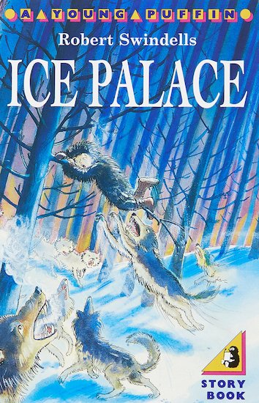
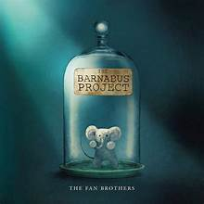
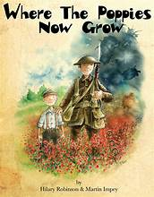
During this term we will be learning…
English | We will start the term with The Barnabus Project by the Fan Brothers. We will be writing character descriptions, letters of advice, advertisements and dialogue. We will move onto Escape from Pompeii by Christina Balit, which we will use for setting descriptions and diaries. Where the Poppies Grow by Hilary Robinson is a narrative poem set in World War 1. We will base our Poetry unit on this theme and include imagery such as personification. We will paragraph our writing using The Ice Palace by Robert Swindells. In Non-fiction we will write a newspaper report, a recount and a persuasive leaflet.
Maths | Place Value, Addition and Subtraction, Multiplication and Division, Area. Throughout the year there will be a strong emphasis on learning Times Tables to prepare children for the statutory Multiplication Check at the end of Year 4. By the end of Year 4 children should be fluent in facts up to 12 x 12.
History | Investigating why the Romans invaded Britain and the reaction of the Celts, including Boudicca. We will also learn how the Romans changed life in Britain and what their legacy is.
Geography | Learn where the Alps are and what the climate is like. We will also consider what it is like to live in the Alps and why people choose to live there.
RE | What is the purpose of sacred buildings or places? We will explore why light is.an important symbol in many World Faiths.
Art and Design | Painting and Mixed Media: Developing skills in colour mixing, focusing on using tints and shades to create a 3D effect. Experimenting with composition and applying painting techniques to a still life composition.
DT | Electrical Systems-Torches: Identify the difference between electrical and electronic products. Evaluate a range of existing torches and their features, then develop a new functional torch design.
Science | Digestion and Food: Children describe the function of key organs in the digestive system. Pupils identify the types of human teeth and investigate factors that impact our dental health. They compare human teeth to other animals’ and take on the role of a naturalist investigating animal faeces for clues about diet, digestion and dentition. Electricity and Circuits: Exploring appliances in their setting that use electricity, learn how to work with electricity safely and build circuits. Investigate electrical conductors and insulators and explore the relationship between the number of cells and bulb brightness.
Computing | Computing systems: Networks. Data Handing: Databases.
Music | Identify motifs aurally and play a repeated pattern on a tuned instrument. Create and perform a motif, notating it with reasonable accuracy. Learn to tell stories through music by creating our own compositions.
PE | Invasion Games: Basketball and Handball. Dance. Gymnastics
French | This is me- Be able to greet each other and introduce themselves. School Days- Learn and use vocabulary related to a school setting.
PSHE | How can I take care of my mind and body? Recognise a range of feelings and emotions. What helps us feel safe and included? Developing self worth and confidence in expressing ourselves.
How can you help your child at home?
Ensure that your child understands the meaning of the key vocabulary for our topics and help them to research the topics we will be covering this term. Talking to your child is the best way to expand their vocabulary and improve their general knowledge. Read lots of books and look for interesting words and phrases in them. What do these words mean and how could they be used? Home reading is a way for children to practise and consolidate the skills they have been taught. We expect children to read at home at least three times a week to support these skills and develop their comprehension skills and vocabulary. Children may also need help with their Spelling and Maths Homework each week.
Thank you for all your continued support. If you have any questions or concerns please just ask!
Key Information for this term.
PE is on Wednesday and Friday.
Maths homework is given on
Thursday to be returned the following Thursday.
Spelling homework is given on a Thursday for a test the following Thursday.
Please practice Times Tables facts on Times Tables Rockstars.
What are we reading this term?

Slide 2

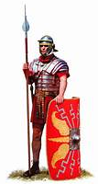
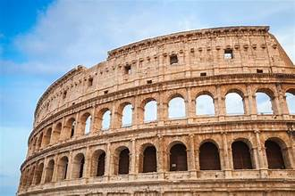
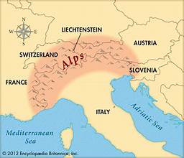
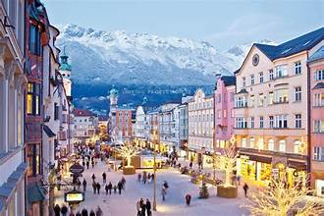
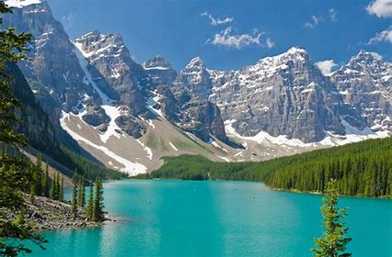
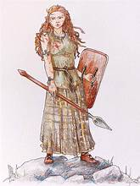

Key vocabulary
Past, chronological order, archaeology, border, civilisation, conquer, emperor, empire, expand, government, hygiene, impact, invasion, leisure, myth, primary source, secondary source, sequence, settlement
Mountain range, peak, summit, base, height, altitude, ridge, slope, face, fold, valley, avalanche, mountaineering.
Questions to get you thinking...
Where is Rome?
What was it like in Ancient Rome?
Why did they invade Britain?
How did the Celtic tribes react?
How did the Roamn Empire end?
What is the legacy of the Roman invasion?
Where are the Alps?
What can be found there?
What is the weather like?
Who lives there?
Why do people visit?
What is a mountain?
How are they formed?
Autumn Curriculum Overview
Year 3/4
Why did the Romans invade and settle in Britain?
What is life like in the Alps
Would you like to visit Innsbruck?
Who was Boudicca?
We are looking forward to welcoming you back to school
and are excited about our new topics. We start the term
with learning all about the invasion and settlement of Britain
by the Romans. We will also find out about how the Celtic
Tribes reacted to the invasion. We will explore ways that the
Romans changed Britain and what their legacy is.
During the second half term we will move on to our
Geography topic of The Alps where we will learn about the mountain environment and tourism within the area.
Please see the individual subject areas in the booklet for
Work covered.
Useful websites
https://www.natgeokids.com/uk/teacher-category/romans/
https://www.historyforkids.net/ancient-rome.html
https://www.ducksters.com/history/ancient_rome.php
https://www.bbc.co.uk/bitesize/topics/zwmpfg8
https://kids.britannica.com/kids/article/ancient-Rome/353728
https://www.primaryhomeworkhelp.co.uk/mountains.htm
https://www.bbc.co.uk/bitesize/topics/z849q6f/articles/z4g3qp3
https://kids.nationalgeographic.com/nature/habitats/article/mountain
Christian Value
Our Christian Value this term is Compassion.
Our Big Question is: Are we looking after God’s creation?
"Life in all its fullness"
John 10:10

