Slide 1
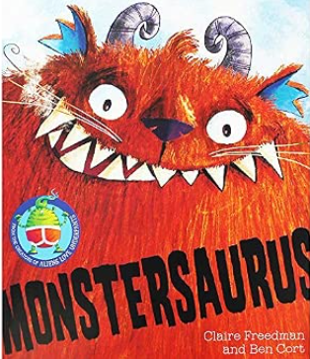
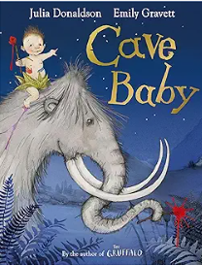
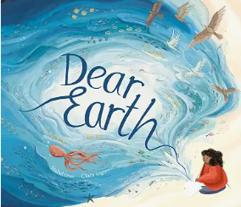
During this term we will be learning…
English | We will start the term with The Colour Monster by Anna Llenas. We will be writing labels, captions and character descriptions. We will move onto Monstersaurus by Claire Freedman, which we will use for character descriptions and recipes. Moving on we will be reading Cave Baby by Julia Donaldson where we will be exploring narrative re-telling, labels/captions, posters and informal letters, as well as drama and oral sentence structure. Pumpkin Soup will be our Autumn based text where will create our own poems. In the second half of the term we will be reading Dear Earth by Isabel Otter where we will be producing informative leaflets, persuasive speeches and letters. This will lead us onto the book We are Water Protectors by Carole Lindstrom where we will write non-chronological reports, list poems and character descriptions.
Maths | Year 1 – Children will complete units of work on Place value (within 10), addition and subtraction, and shape. Year 2 – Children will complete units of work on Place value, addition and subtraction and shape.
History | This term in History, we will be learning about the past and how we know about it. We will explore timelines and learn how to put events in the correct order, as well as thinking about how people and their lives change over time. The children will compare life today with life in the past, looking at what has changed and what has stayed the same.
Geography | This term in Geography, we will be developing our map and geographical skills. The children will learn to locate the seven continents and five oceans of the world and identify the four countries and capital cities of the UK. We will explore the human and physical features of cities and our local area, including rivers, and use maps, atlases, globes and aerial photographs to investigate places.
RE | Why are sacred texts so important to people of faith? We will be looking at different Holy texts and exploring why they are special.
Art and Design | This term in Art, we will be exploring sculpture and 3D artwork. The children will learn how to roll, shape and join paper to create interesting 3D forms, making their own ‘Tree of Life’ sculptures. They will experiment with arranging, overlapping and decorating paper shapes to add detail and interest, while developing their confidence in making creative choices.
DT | Textiles - Developing textile skills to design and create hand puppets based on characters from a well-known fairy tale.
Science | This term in Science, we will be learning about our bodies and our five senses. The children will identify and label different parts of the human body and learn which body parts are linked to each of our senses. In the second half of the term we will be learning about everyday materials. We will also be exploring signs of Autumn.
Computing | Programming: Beebots. Creating Media: Digital imigery .
Music | My Favourite Things; Keeping the Pulse- In this unit, the children will explore keeping the pulse together through music and movement, by exploring their favourite things
PE | Fundemental Skills including under arm throwing.
PSHE | Identifying what makes them and others special. We will learn how friends, family and classmates can help and support each other.
How can you help your child at home?
We work hard in class to teach children the skills they require to succeed in reading through discreet phonics lessons and shared whole class reading. Home reading is a way for children to practise and consolidate the skills they have been taught. We expect children to read at home at least three times a week to support these skills and develop their comprehension skills and vocabulary. Talking to your child about what they are reading and asking them questions is the best way to expand their vocabulary and develop comprehension skills.
Year 2 have started spellings on Spelling Shed, so please help your child by testing them on the words they are learning to spell and ensuring they understand the meaning of the words.
Year 1 children will be given spellings after Christmas.
Key Information for this term.
PE is on Wednesday.
Forest Schools is on a Thursday.
Spelling homework is given on a Friday for a test the following Friday.
What are we reading this term?

Slide 2
Key vocabulary we are using this term
History | Change, different, event, future, memory, past, present, similar, timeline
Geography | Aerial photograph, capital city, continent, country, data collection, fieldwork, human feature, key, lake, land, landmark, locate, map, north, physical feature, ocean, river, sea, scale, symbol
RE | Bible, Old Testament, New Testament, holy, Gospel, Word of God, Mary Jones, Dead Sea Scrolls, Qur’an, Torah scroll, Ark, Guru Granth Sahib, chauri, Rumala Sahib
Art and Design | Bend, fold, overlap, roll, sculpture, scrunch, spiral, three dimensional (3D),zig-zag
DT | Decorate, design, fabric, model, staple, safety pin, stencil, template
Science | Compare, group, pattern, sense(s), absorbent, group, material, waterproof
Computing | Command, error, instructions, program

