Slide 1


Reception Long - Term Plan 25-26

Slide 2







Reception Long - Term Plan 25-26
 | Autumn 1 | Autumn 2 | Spring 1 | Spring 2 | Summer 1 | Summer 2
General Themes NB: These themes may be adapted at various points to allow for children’s interests to flow through the provision | All about me My new class Human body How have I changed? My family / PSED focus What am I good at? How do I make others feel? Being kind | Terrific tales Traditional Tales Stories based around dinosaurs The Nativity Christmas Lists Letters to Father Christmas | Amazing animals Life cycles Hibernation Down on the Farm Mini Beasts Animal Arts and crafts Animal patterns Happy Habitats | Come outside Weather / seasons The great outdoors Forest School Looking after our world Reduce, Reuse & Recycle Fun Science / Materials | Ticket to ride Around the Town How do I get there? Where in the world have you been? Where do we live in the UK / world? Fly me to the moon! Vehicles past and Present Design your own transport! Who was Neil Armstrong? | Fun at the seaside Under the sea Off on holiday / clothes Where in the world shall we go? Send me a postcard! Marine life Seasides in the past Compare: Now and then! Seaside art
Possible Texts and ‘old favourites’ | Funny Bones | Little Red Hen Old favorites Familiar tales Hansel and Gretel The Three Little Pigs | The Very Hungry Caterpillar The grouchy ladybird What the ladybird heard | One Plastic Bag Tree, Seasons come and seasons go A stroll through the seasons | The Snail and the Whale The Way back Home The Naughty Bus Mr. Gumpy’s Outing The Train Ride Bob, The Man on the Moon Beegu Oi! Get off my train! | Lighthouse Keeper’s Lunch Under the Sea Non – Fiction P is for Passport The Journey Zoom Passport to Paris World Atlases Tiddler
‘Wow’ moments / Enrichment Weeks | Autumn Trail Harvest Time Birthdays Favourite Songs | Guy Fawkes / Bonfire Night Christmas Time / Nativity Diwali Remembrance day Children in Need | Chinese New Year Valentine’s Day Internet Safety Day Animal Art week Farm/vet role play | Easter time Weather experiments Weather Forecast videos Nature Scavenger Hunt Mother’s Day Science Week Eater Egg Hunt | Bus ride Map work Vehicle visits Start of Ramadan Eid | Under the Sea – singing songs and sea shanties Father’s Day Heathy Eating Week World Environment Day Pirate Day Ice – Cream at the park

Slide 3

Reception Long - Term Plan 25-26
 | Autumn 1 | Autumn 2 | Spring 1 | Spring 2 | Summer 1 | Summer 2
General Themes | All about me | Terrific tales | Amazing animals | Come outside | Ticket to ride | Fun at the seaside
 | Characteristics of Effective Learning Playing and exploring: - Children investigate and experience things, and ‘have a go’. Children who actively participate in their own play develop a larger store of information and experiences to draw on which positively supports their learning Active learning: - Children concentrate and keep on trying if they encounter difficulties. They are proud of their own achievements. For children to develop into self-regulating, lifelong learners they are required to take ownership, accept challenges and learn persistence. Creating and thinking critically: - Children develop their own ideas and make links between these ideas. They think flexibly and rationally, drawing on previous experiences which help them to solve problems and reach conclusions.
Over Arching Principles | Unique Child: Every child is unique and has the potential to be resilient, capable, confident and self-assured. Positive Relationships: Children flourish with warm, strong & positive partnerships between all staff and parents/carers. This promotes independence across the EYFS curriculum. Children and practitioners are NOT alone – embrace each community. Enabling environments: Children learn and develop well in safe and secure environments where routines are established and where adults respond to their individual needs and passions and help them to build upon their learning over time. Learning and Development: Children develop and learn at different rates (not in different ways as it stated 2017). We must be aware of children who need greater support than others.
COEL

Slide 4

Reception Long - Term Plan 23-24
 | Autumn 1 | Autumn 2 |  | Spring 1 |  | Spring 2 |  | Summer 1 |  | Summer 2
General Themes | All about me | Terrific tales |  | Amazing animals |  | Come outside |  | Ticket to ride |  | Fun at the seaside
Communication and Language | The development of children’s spoken language underpins all seven areas of learning and development. Children’s back-and-forth interactions from an early age form the foundations for language and cognitive development. The number and quality of the conversations they have with adults and peers throughout the day in a language-rich environment is crucial. By commenting on what children are interested in or doing, and echoing back what they say with new vocabulary added, practitioners will build children's language effectively. Reading frequently to children, and engaging them actively in stories, non-fiction, rhymes and poems, and then providing them with extensive opportunities to use and embed new words in a range of contexts, will give children the opportunity to thrive. Through conversation, story-telling and role play, where children share their ideas with support and modelling from their teacher, and sensitive questioning that invites them to elaborate, children become comfortable using a rich range of vocabulary and language structures.
Whole EYFS Focus – C&L is developed throughout the year through high quality interactions, daily group discussions, sharing circles, PSHE times, stories, singing, speech and language interventions, Pie Corbett T4W, EYFS productions, assemblies and weekly interventions. Daily story time | Settling in activities Making friends Children talking about experiences that are familiar to them This is me! Rhyming and alliteration Familiar Print Sharing facts about me! Colour Monsters Shared stories All about me! Model talk routines through the day. For example, arriving in school: “Good morning, how are you?” |  | Settling in activities Develop vocabulary Tell me a story - retelling stories Story language Word hunts Listening and responding to stories Following instructions Takes part in discussion Understand how to listen carefully and why listening is important. Use new vocabulary through the day. Choose books that will develop their vocabulary. |  | Using language well Ask’s how and why questions… Retell a story with story language Story invention – talk it! Ask questions to find out more and to check they understand what has been said to them. Describe events in some detail. Listen to and talk about stories to build familiarity and understanding. Learn rhymes, poems and songs. |  | Settling in activities Describe events in detail – time connectives Understand how to listen carefully and why listening is important. Use picture cue cards to talk about an object: “What colour is it? Where would you find it? Sustained focus when listening to a story |  | Settling in activities Re-read some books so children learn the language necessary to talk about what is happening in each illustration and relate it to their own lives |  | Show and tell Weekend news Read aloud books to children that will extend their knowledge of the world and illustrate a current topic. Select books containing photographs and pictures, for example, places in different weather conditions and seasons.

Slide 5


Reception Long - Term Plan 23-24
 | Autumn 1 | Autumn 2 | Spring 1 | Spring 2 | Summer 1 | Summer 2
General Themes | All about me | Terrific tales | Amazing animals | Come outside | Ticket to ride | Fun at the seaside
Personal, Social and Emotional Development | Children’s personal, social and emotional development (PSED) is crucial for children to lead healthy and happy lives and is fundamental to their cognitive development. Underpinning their personal development are the important attachments that shape their social world. Strong, warm and supportive relationships with adults enable children to learn how to understand their own feelings and those of others. Children should be supported to manage emotions, develop a positive sense of self, set themselves simple goals, have confidence in their own abilities, to persist and wait for what they want and direct attention as necessary. Through adult modelling and guidance, they will learn how to look after their bodies, including healthy eating, and manage personal needs independently. Through supported interaction with other children, they learn how to make good friendships, co-operate and resolve conflicts peaceably. These attributes will provide a secure platform from which children can achieve at school and in later life.
Managing Self Self - Regulation | Show an understanding of their own feelings and those of others and begin to regulate their behaviour accordingly. Set and work towards simple goals, being able to wait for what they want and control their immediate impulses when appropriate. Give focused attention to what the teacher says, responding appropriately even when engaged in activity, and show an ability to follow instructions involving several ideas or actions. Controlling own feelings and behaviours Applying personalised strategies to return to a state of calm Being able to curb impulsive behaviours Being able to concentrate on a task Being able to ignore distractions Behaving in ways that are pro-social Planning Thinking before acting Delaying gratification Persisting in the face of difficulty. Follow the Kapow scheme of work PSED

Slide 6

Reception Long - Term Plan 25-26
 | Autumn 1 | Autumn 2 | Spring 1 | Spring 2 | Summer 1 | Summer 2
General Themes | All about me | Terrific tales | Amazing animals | Come outside | Ticket to ride | Fun at the Seaside
Literacy:Writing Texts may vary due to children’s interests Only ask children to write sentences when they have sufficient knowledge of letter-sound correspondences. | Focus on pencil control, name writing and general mark making both adult led and independently. Giving meaning to marks and labelling. Writing initial learnt sounds, tricky words and captions. Texts as a stimulus The Colour Monster Using initial sounds to label different feelings. Retelling and sequencing stories. | Literacy tree: Oi Frog Focus on rhyming, use sound talk, using phonics knowledge to help with reading and spelling. Using a variety of stories through our topic-terrific tales; listen and recall, ask questions, write captions and simple words, predict story endings. Christmas story – writing activities at the writing tables. | Literacy tree: Hairy McClairy. Focus on character descriptions, answering questions and using phonetic knowledge to read simple sentences. Introduce the idea of fiction/non-fiction, looking at animal information books Animal fact file-Writing some of the tricky words such as I, me, my, like, to, the. Writing CVC words, Labels using CVC, CVCC, CCVC words. | . Literacy tree- The tiny seed by Eric Carle Writing labels and captions, writing in role. Easter- Order the Easter story. Labels and captions. | T4W Texts as a Stimulus: The Naughty Bus – retell parts of the story / repeated refrains / speech bubbles Labelling/writing captions for different parts of the story Writing own versions of the ending. | T4W Texts as a Stimulus: What the Ladybird heard at the seaside. Story writing, writing sentences using a range of tricky words that are spelt correctly. Beginning to use full stops, capital letters and finger spaces. Innovation of familiar texts Using familiar texts as a model for writing own stories. Write a postcard/holiday diary.

Slide 7

 | Autumn 1 | Autumn 2 | Spring 1 | Spring 2 | Summer 1 | Summer 2
Phonics Following Red Rose Phonics | Through the teaching of Red Rose Letters and Sounds we ensure a rigorous and thorough planning programme is followed in order to strengthen the teaching and learning of phonics, and ensure children become enthusiastic and successful readers and writers. Our aims: Our children are entitled to a Phonics curriculum which enables them to: • gain a progressively deeper understanding of the phonetic structure of the English language. • apply their phonic knowledge and skills to decode unfamiliar words fluently and accurately. • read rapidly to apply what they have learned across the whole curriculum. • create fluent readers, confident speakers and willing writers. • develop a life-long love of reading.
Maths | Phase 2 Teach 12 GPCs Teach 1 Tricky Word | Phase 2 Teach 11 GPCs Teach 5 Tricky Words | Phase 3 Teach 13 GPCs Teach 9 Tricky Words | Phase 3 Teach 8 GPCs Teach 8 Tricky Words | Phase 3 Teach 7 GPCs Teach 9 Tricky Words | Phase 4 Teach CCVC & CCVCC CCCVC & CCCVCC Polysyllabic words containing Phase 2 and 3 graphemes with adjacent consonants. Consolidate Phase 3/4 Tricky Words as required
 |  |  |  |  | Phase 4 Teach CVCC & CCV Consolidate Phase 3/4 Tricky Words as required
 | Consolidate Phase 1 s a t p i n m d g o c k s pronounced /z/ | ck e u r h b f ff l ll ss Consolidate Phase 2 | j v w x y z/zz qu ch sh th/th ng Consolidate as required | ai ee igh oa with two-syllable words oo/oo with two-syllable words ar or with two-syllable words Consolidate as required | Phase 3 ur ow oi ear (Including pseudo words) air ure er (Including pseudo words) Consolidate Phase 3 Phase 4 CVCC & CCV | CCVC & CCVCC CCCVC & CCCVCC Polysyllabic words containing Phase 2 and 3 graphemes with adjacent consonants.
 | HFW & Tricky Words | Tricky Words | Tricky Words | Tricky Words | Tricky Words | Tricky Words
 | High Frequency Words as is us his has linked to s pronounced /z/ the | I to go no into | he she we be me was my you they | her all are (Phase 3) like (Phase 4) said when (Phase 4) have one (Phase 4) | come do (Phase 4) so were (Phase 4) some there (Phase 4) out little what (Phase 4) Consolidate said so have like (Phase 4) | Consolidate said so have like some come were there little do one when out what Teach it’s

Slide 8

Reception Long - Term Plan 23-24
 | Autumn 1 | Autumn 2 | Spring 1 | Spring 2 | Summer 1 | Summer 2
General Themes | All about me | Terrific tales | Amazing animals | Come Outside | Ticket to ride | Fun at the seaside
Maths White Rose maths scheme.
Maths | Number Match and sort Compare amounts Measure, space and spatial thinking Compare size, mass and capacity Exploring pattern | Number Representation, comparison and composition of numbers 1-3 Representing numbers to 5 One more and less. Measure, space and spatial thinking Circles and triangles Positional language Shapes with 4 sides Time | Number Introducing zero Comparing numbers to 5 Composition of 4 and 5. 6,7,8. Making pairs Combining two groups. Measure, space and spatial thinking Compare mass Compare capacity Length and height Time | Number 9 and 10 Comparing numbers to 10 Bonds to 10 Measure, space and spatial thinking 3D shape Pattern Consolidation of all Spring learning. | Number Building numbers beyond 10 Counting patterns beyond 10. Adding more Taking away Measure, space and spatial thinking Spatial reasoning, match, rotate and manipulate Compose and decompose. | Depth of numbers within 20 Explore numbers and strategies •Recognise and extend patterns •Apply number, shape and measures knowledge •Count forwards and backwards Numbers beyond 20 One more one less •Estimate and count •Grouping and sharing | Number Doubling Sharing and grouping Even and odd Deepening understanding Patterns and relationships. Measure, space and spatial thinking Spatial reasoning Visualise and build Mapping

Slide 9




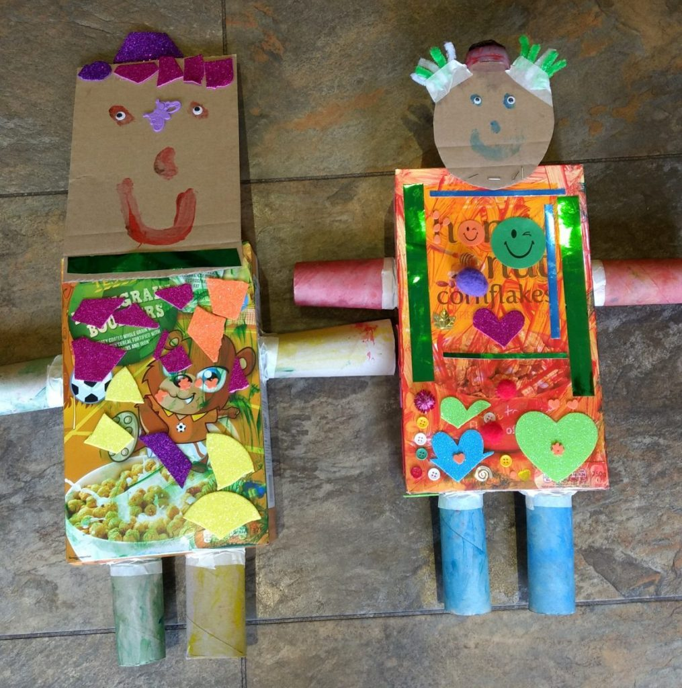
Reception Long - Term Plan 23-24
 | Autumn 1 | Autumn 2 | Spring 1 | Spring 2 | Summer 1 | Summer 2
General Themes | All about me | Terrific tales | Amazing animals | Come outside | Ticket to ride | Fun at the seaside
Expressive Arts and Design Painting, 3D modelling, messy play, collage, cutting, drama, role play, threading, moving to music, clay sculptures, following music patterns with instruments, singing songs linked to topics, making instruments, percussion. | Exploring and using media and materials' focuses on how young children engage with the many materials and creative experiences presented to them. For children within the EYFS, this will be through their senses and whole-body movements, as they discover the properties of materials (what they can and can't do), the way that music urges them to move rhythmically and with enjoyment, and how they can express themselves through, for example, colour. The development of children’s artistic and cultural awareness supports their imagination and creativity. It is through this variety of experiences that children recreate their world and interpret their own ideas. This lies at the heart of creativity and expression and has many links to the other areas of learning. Children in Class 1 will have regular opportunities to engage with the arts, enabling them to explore and play with a wide range of media and materials. We believe that children need to experience at first hand the consequences of the decisions they have made, rather than quickly being shown by an adult how to get it 'right'. Children in class one are given regular opportunities to experience purposeful making activities, allowing them to demonstrate their creativity, imagination - as well as making mistakes.
Expressive Arts and Design Painting, 3D modelling, messy play, collage, cutting, drama, role play, threading, moving to music, clay sculptures, following music patterns with instruments, singing songs linked to topics, making instruments, percussion. Children to produce a piece of art work each half term to be displayed for ‘Celebration wall’ for school / parents to show how drawings have developed - lots of links to Fine Motor Skills. Children to explain their work to others. Children will have opportunities to learn and perform songs, nursery rhymes and poetry linked to their work / interests and passions. | Drawing skills (Kapow) Mark making with different media Observational pencil drawings Drawing faces Drawing faces in colour Autumnal art- drawing, painting, printing pumpkins. | Use different textures and materials to make houses for the three little pigs, bridges for the three billy goats gruff. Design, bake and decorate Gingerbread men. Firework pictures. Christmas decorations, Christmas cards, Christmas songs/poems Role Play of The Nativity | Sculpture and 3D (Kapow) Manipulation and experimentation using clay and playdough. 3D landscape art Design, create and paint animal sculptures. Animal prints Making animal masks Clay modelling of different animals. Breif look at Chinese New Year – Chinese dragon/lion dancing, making puppets. Owl art? | Artwork themed around Eric Carle- The seasons poster. Explore what can be made (artwork) from recycling, make a whole class piece. Recycling center role play area. Mother’s Day crafts Easter crafts | Design and make rockets. Design and make objects they may need in space, thinking about form and function. Large construction items to make own vehicles outside. Junk modelling of vehicles. Choose a country that the children could fly to and learn about that country's culture and way of life. Learn a song/dance from that country. | Sand pictures Puppet shows Salt dough fossils Water pictures, collage shading, adding beach huts. Under the sea art. Father’s Day Crafts

Slide 10
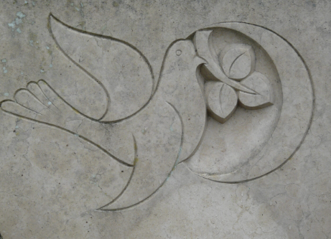
Reception Long - Term Plan 23-24
 | Autumn 1 | Autumn 2 | Spring 1 | Spring 2 | Summer 1 | Summer 2
General Themes | I am special & Harvest | Special people & Christmas | Stories Jesus told & Stories Jesus heard. | Easter | Friendship & My special places | Prayer & Special times
Religious Education | We are unique children of God God as a loving Father Feelings and Emotions My gifts and talents Giving thanks for food and God’s many gifts to us Story of Creation and exploring the wonders of our amazing world . | People who love us and help us People we trust Significant role models Exploring Christian values through the actions of others Theme: Births and Birthdays Nativity Story Festivals of Light – Inc. Non-Christian Faith | The lost coin The lost sheep The Good Samaritan The wise man and the foolish man. | Theme : Love Palm Sunday Good Friday Easter Sunday Emotions | Qualities of friendship Jesus is our friend Friends of Jesus My special places The Church including a visit Christian Artefacts Non-Christian Faith places of Worship | What is prayer? How do we pray? Why do people pray? Prayer in other faith Baptism Weddings Family celebrations Links with Non-Christian Faith celebrations
Core Principles | Believe and Achieve – focusing on our school Christian values. In class worship time twice a week and Friday celebration assembly, children will begin to attend whole school collective worship later on in the Autumn term.

Slide 11


Early Learning Goals – for the end of the year - best fit Judgement! | Early Learning Goals | Autumn 2
Communication and Language | Personal, social, emotional development | Physical Development
ELG: Listening, Attention and Understanding Listen attentively and respond to what they hear with relevant questions, comments and actions when being read to and during whole class discussions and small group interactions Make comments about what they have heard and ask questions to clarify their understanding Hold conversation when engaged in back-and-forth exchanges with their teacher and peers ELG: Speaking Participate in small group, class and one-to-one discussions, offering their own ideas, using recently introduced vocabulary. Offer explanations for why things might happen, making use of recently introduced vocabulary from stories, non-fiction, rhymes and poems when appropriate. Express their ideas and feelings about their experiences using full sentences, including use of past, present and future tenses and making use of conjunctions, with modelling and support from their teacher. | ELG: Self-Regulation Show an understanding of their own feelings and those of others, and begin to regulate their behaviour accordingly. Set and work towards simple goals, being able to wait for what they want and control their immediate impulses when appropriate. Give focused attention to what the teacher says, responding appropriately even when engaged in activity, and show an ability to follow instructions involving several ideas or actions. ELG: Managing Self Be confident to try new activities and show independence, resilience and perseverance in the face of challenge. Explain the reasons for rules, know right from wrong and try to behave accordingly. Manage their own basic hygiene and personal needs, including dressing, going to the toilet and understanding the importance of healthy food choices. ELG: Building Relationships Work and play cooperatively and take turns with others. Form positive attachments to adults and friendships with peers;. Show sensitivity to their own and to others’ needs. | ELG: Gross Motor Skills Negotiate space and obstacles safely, with consideration for themselves and others. Demonstrate strength, balance and coordination when playing. Move energetically, such as running, jumping, dancing, hopping, skipping and climbing. ELG: Fine Motor Skills Hold a pencil effectively in preparation for fluent writing – using the tripod grip in almost all cases. Use a range of small tools, including scissors, paint brushes and cutlery. Begin to show accuracy and care when drawing.

Slide 12


Early Learning Goals – for the end of the year - best fit Judgement! | Spring 2
Literacy | Maths
ELG: Comprehension Demonstrate understanding of what has been read to them by retelling stories and narratives using their own words and recently introduced vocabulary. Anticipate – where appropriate – key events in stories. Use and understand recently introduced vocabulary during discussions about stories, non-fiction, rhymes and poems and during role-play. ELG: Word Reading Say a sound for each letter in the alphabet and at least 10 digraphs. Read words consistent with their phonic knowledge by sound-blending. Read aloud simple sentences and books that are consistent with their phonic knowledge, including some common exception words. ELG: Writing Write recognisable letters, most of which are correctly formed. Spell words by identifying sounds in them and representing the sounds with a letter or letters. Write simple phrases and sentences that can be read by others. | ELG: Number Have a deep understanding of number to 10, including the composition of each number; Subitise (recognise quantities without counting) up to 5; - Automatically recall (without reference to rhymes, counting or other aids) number bonds up to 5 (including subtraction facts) and some number bonds to 10, including double facts. ELG: Numerical Patterns Verbally count beyond 20, recognising the pattern of the counting system; - Compare quantities up to 10 in different contexts, recognising when one quantity is greater than, less than or the same as the other quantity. Explore and represent patterns within numbers up to 10, including evens and odds, double facts and how quantities can be distributed equally.

Slide 13


Early Learning Goals – for the end of the year - best fit Judgement! | Summer 2
Understanding the World | Expressive arts and design
ELG: Past and Present Talk about the lives of the people around them and their roles in society. Know some similarities and differences between things in the past and now, drawing on their experiences and what has been read in class. Understand the past through settings, characters and events encountered in books read in class and storytelling. ELG: People, Culture and Communities Describe their immediate environment using knowledge from observation, discussion, stories, non-fiction texts and maps. Know some similarities and differences between different religious and cultural communities in this country, drawing on their experiences and what has been read in class. Explain some similarities and differences between life in this country and life in other countries, drawing on knowledge from stories, non-fiction texts and – when appropriate – maps. ELG: The Natural World Explore the natural world around them, making observations and drawing pictures of animals and plants. Know some similarities and differences between the natural world around them and contrasting environments, drawing on their experiences and what has been read in class. Understand some important processes and changes in the natural world around them, including the seasons and changing states of matter. | ELG: Creating with Materials Safely use and explore a variety of materials, tools and techniques, experimenting with colour, design, texture, form and function. Share their creations, explaining the process they have used; - Make use of props and materials when role playing characters in narratives and stories. ELG: Being Imaginative and Expressive Invent, adapt and recount narratives and stories with peers and their teacher. Sing a range of well-known nursery rhymes and songs; Perform songs, rhymes, poems and stories with others, and – when appropriate – try to move in time with music.

